Slide 1

Air pollution monitoring, forecasting and controlling system
BMS College of Engineering
Department of Information Science and Engineering
CAPSTONE PROJECT
Batch No:- 25
Project Team Members:
Prateek M Gummaraju (1BM19IS117)
Ruchi Aggarwal (1BM19IS133)
Samartha S (1BM19IS219)
Under the Guidance of
Prof. Pallavi B
Assistant Professor
Department of ISE

Slide 2
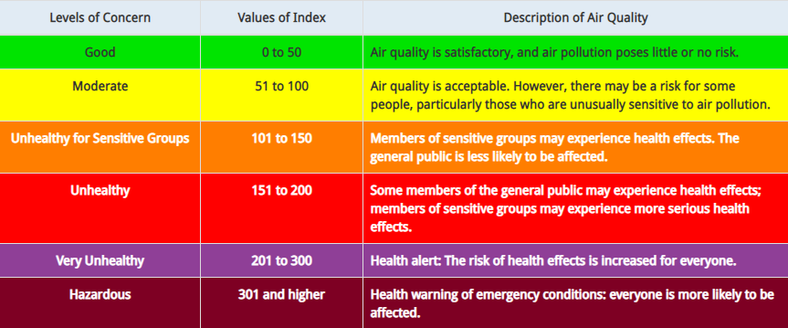
Introduction
Air pollution is defined as the presence of compounds in the atmosphere that are harmful to human beings and other living organisms
Has severe effects on human health - Respiratory issues, lungs and heart problems
Offering a holistic approach to tackle the issue of air pollution by building a device that can monitor air pollution, predict future levels of pollution and also suggest precautionary actions and methods to reduce air pollution

Slide 3
Motivation
Air pollution claims 7 million lives a year making it the most dangerous type of pollution
No present technology that is implemented on a large scale in urban areas
Lack of effective mobile apps
Lack of awareness
Demonstrate the possibility of a device to tackle to this problem which is:
  Cost effective
  Compact
  Easy to use
Help Bengaluru remain the Garden City of India for many years to come

Slide 4
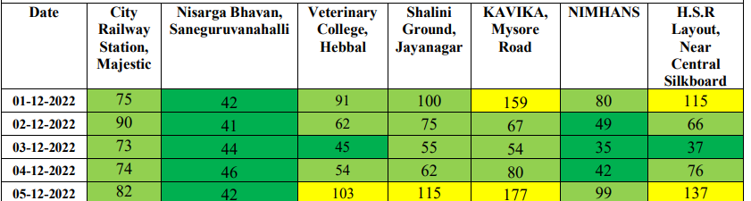
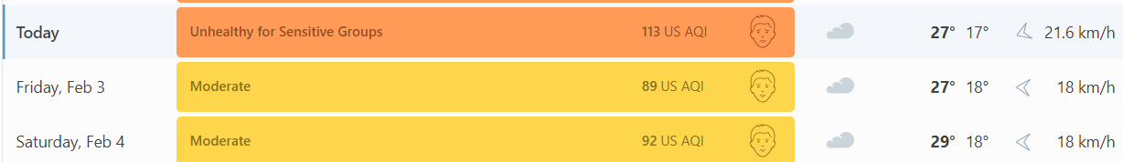
Existing System
There is no one stop solution for eliminating air pollution. With the rising trends of population expansion, urbanisation, industrialization, and increased affluence, the number of potential sources of air pollution grows quickly every year.
The only way people can get accurate updates on air pollution is by reading the Government report at the end of each month. This gives a day by day AQI breakdown for 7 major areas in Bangalore.
Another option is going by existing websites; but these only predict AQI of Bangalore as whole, which as can be seen from the above example, may not be very accurate. For example, www.iqair.com.

Slide 5
Proposed System
We propose to build an IoT device using Arduino Uno and several sensors to detect pollutants such as Particulate Matter, Nitrogen Oxides, Sulphur Dioxide, Ozone, Carbon Monoxide, etc. Using hourly values of these sensors, we will calculate the sub indices of each pollutant and hence the AQI. AQI will be calculated per day.
Using the collected AQI data, and existing dataset from 2015 to 2020, and 2021-2022, we aim to build a Machine Learning model to forecast the AQI for the coming few days in Jayanagar-Basavanagudi region.
Why only this region? Because the AQI at any given time varies all over Bangalore. Hence, if we can model one area accurately, repeating the same for all other areas should be easy.
We aim to build a website showing daily forecasts of AQI, giving tips on reducing the AQI and precautionary measures to help people negate the effects of pollution, especially for people suffering from respiratory and cardiovascular complications.
We are also planning to implement an automated tweeting system to push tweets on Twitter everyday once the prediction has been made, to ensure easy access of information to all residents.

Slide 6
Objectives
Build an IoT system to monitor Air Quality:
  a) Monitor Concentrations of different air pollutants
  b) Measure AQI
Build a model to predict the Air Quality in the near future, using the output of the IoT system as input.
Build a web application to display the real time findings.
Provide analytics on the website, such as the maximum recommended limit and the current concentration.
Provide measures to improve Air Quality.
Provide precautionary measures.
Bring about air pollution awareness

Slide 7
Applications
Protecting the environment, ecosystem and biodiversity of the planet
Protecting the environment, ecosystem and biodiversity of the planet
Industrial compliance and regulations
Integration with Google Maps
Policy making
City planning
Research
Education and awareness

Slide 8
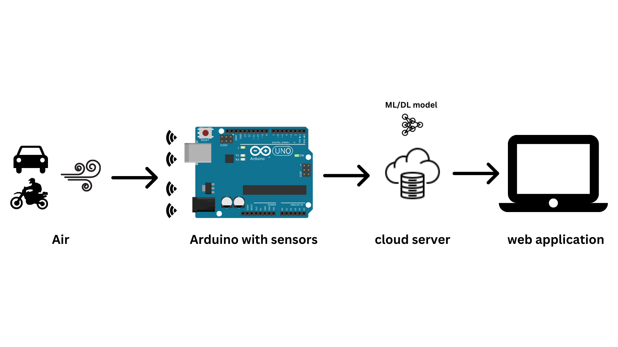
SYSTEM DESIGN
System Architecture

Slide 9
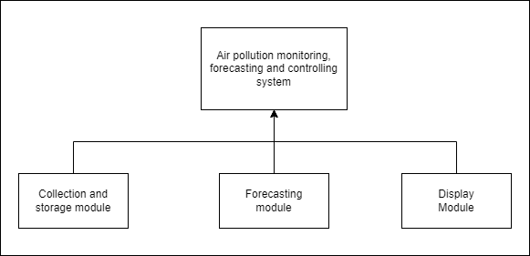
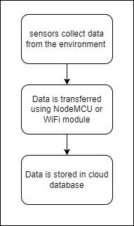
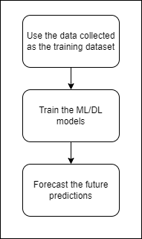
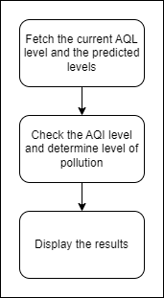
Module Design

Slide 10
THANK YOU

